Slide 1
Essay 2 Beginning

Slide 2
Essay 2 Beginning
Introduce the reader to your topics/texts
Introduce the Fundamental Structure to your essay
Set up the intellectual moves that you’ll be making
Provide a roadmap of the structure of your essay
Offer a brief evaluation of an Established View
Merit(s) of the argument in the EV
Flaw(s) of the argument in the EV
Suggest a correction to the flaw(s) – a new interpretation that will become your thesis

Slide 3
Essay 2 Beginning Summary & Focus Paragraph
Begin with a summary that is tailored toward your problem
Make sure to balance the topical w/the geographic
Transition from your summary to your focus paragraph.
Introduce a problem in the text that leads to a series of questions that need to be answered.
Problem should be something that Chism speaks to
Introduce the Established View (author’s name, title, genre)
Chism genre: article / essay / book chapter
How does the EV answer the Qs or speak to the problem?

Slide 4
Essay 2 Beginning Summary & Focus Paragraph
How does the EV answer the Qs or speak to the problem?
Briefly summarize EV’s claims about the problem
Evaluate the EV
Briefly describe the merit(s) of the EV.
Introduce a flaw in the EV – (“But,” “However,” “Yet”)
Offer a correction to the EV that will become your thesis
Suggest why the problem is important to consider and how your thesis points toward this broader consideration (motive)

Slide 5
Essay 2 Beginning Merit Paragraph
First Body Paragraph: Merit to the EV
Go in depth about the merit you introduce in the focus paragraph
Introduce the claim you’re considering
Quote directly from Chism’s article
Look for evidence in Ibn Battuta that supports the claim
This may be the same evidence Chism points to
You might also look elsewhere in IB’s text
Goal of this paragraph is to establish a baseline interpretation / answer to your questions that you will go on to finesse in the rest of your essay

Slide 6
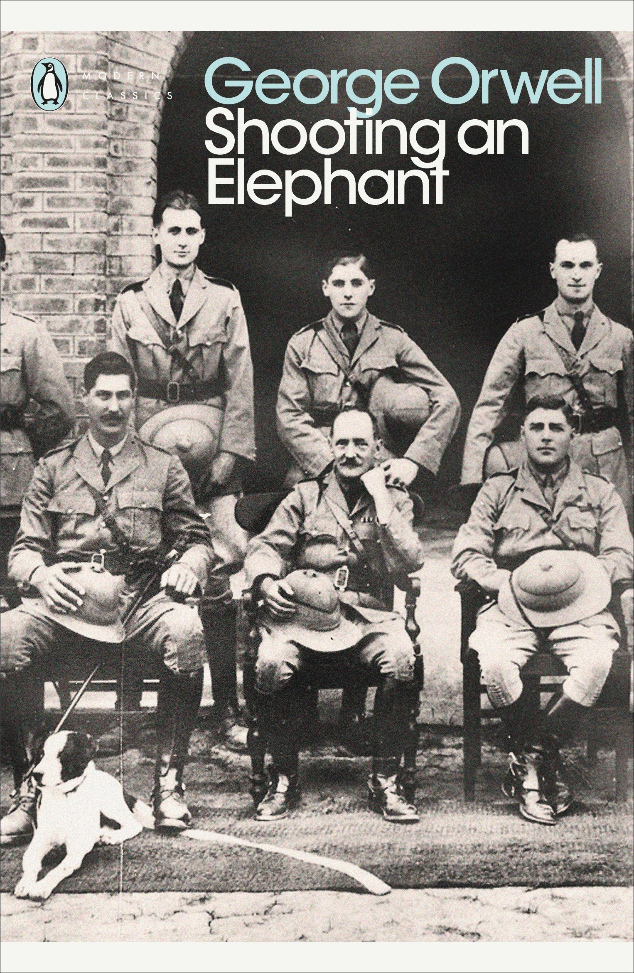
George Orwell
Shooting an Elephant (c. 1936)

Slide 7
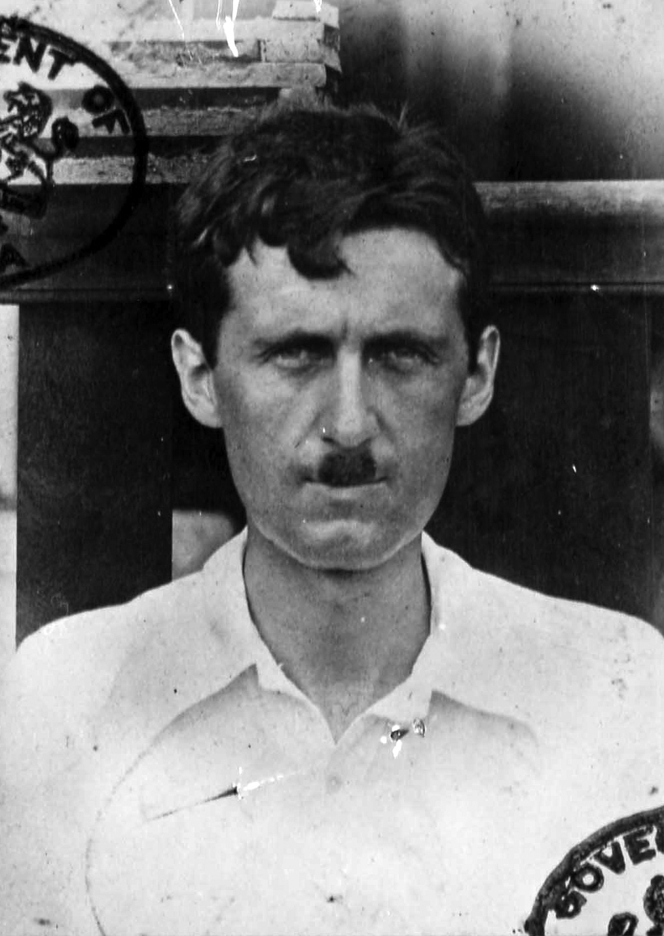
George Orwell
Shooting an Elephant (c. 1936)

Slide 9
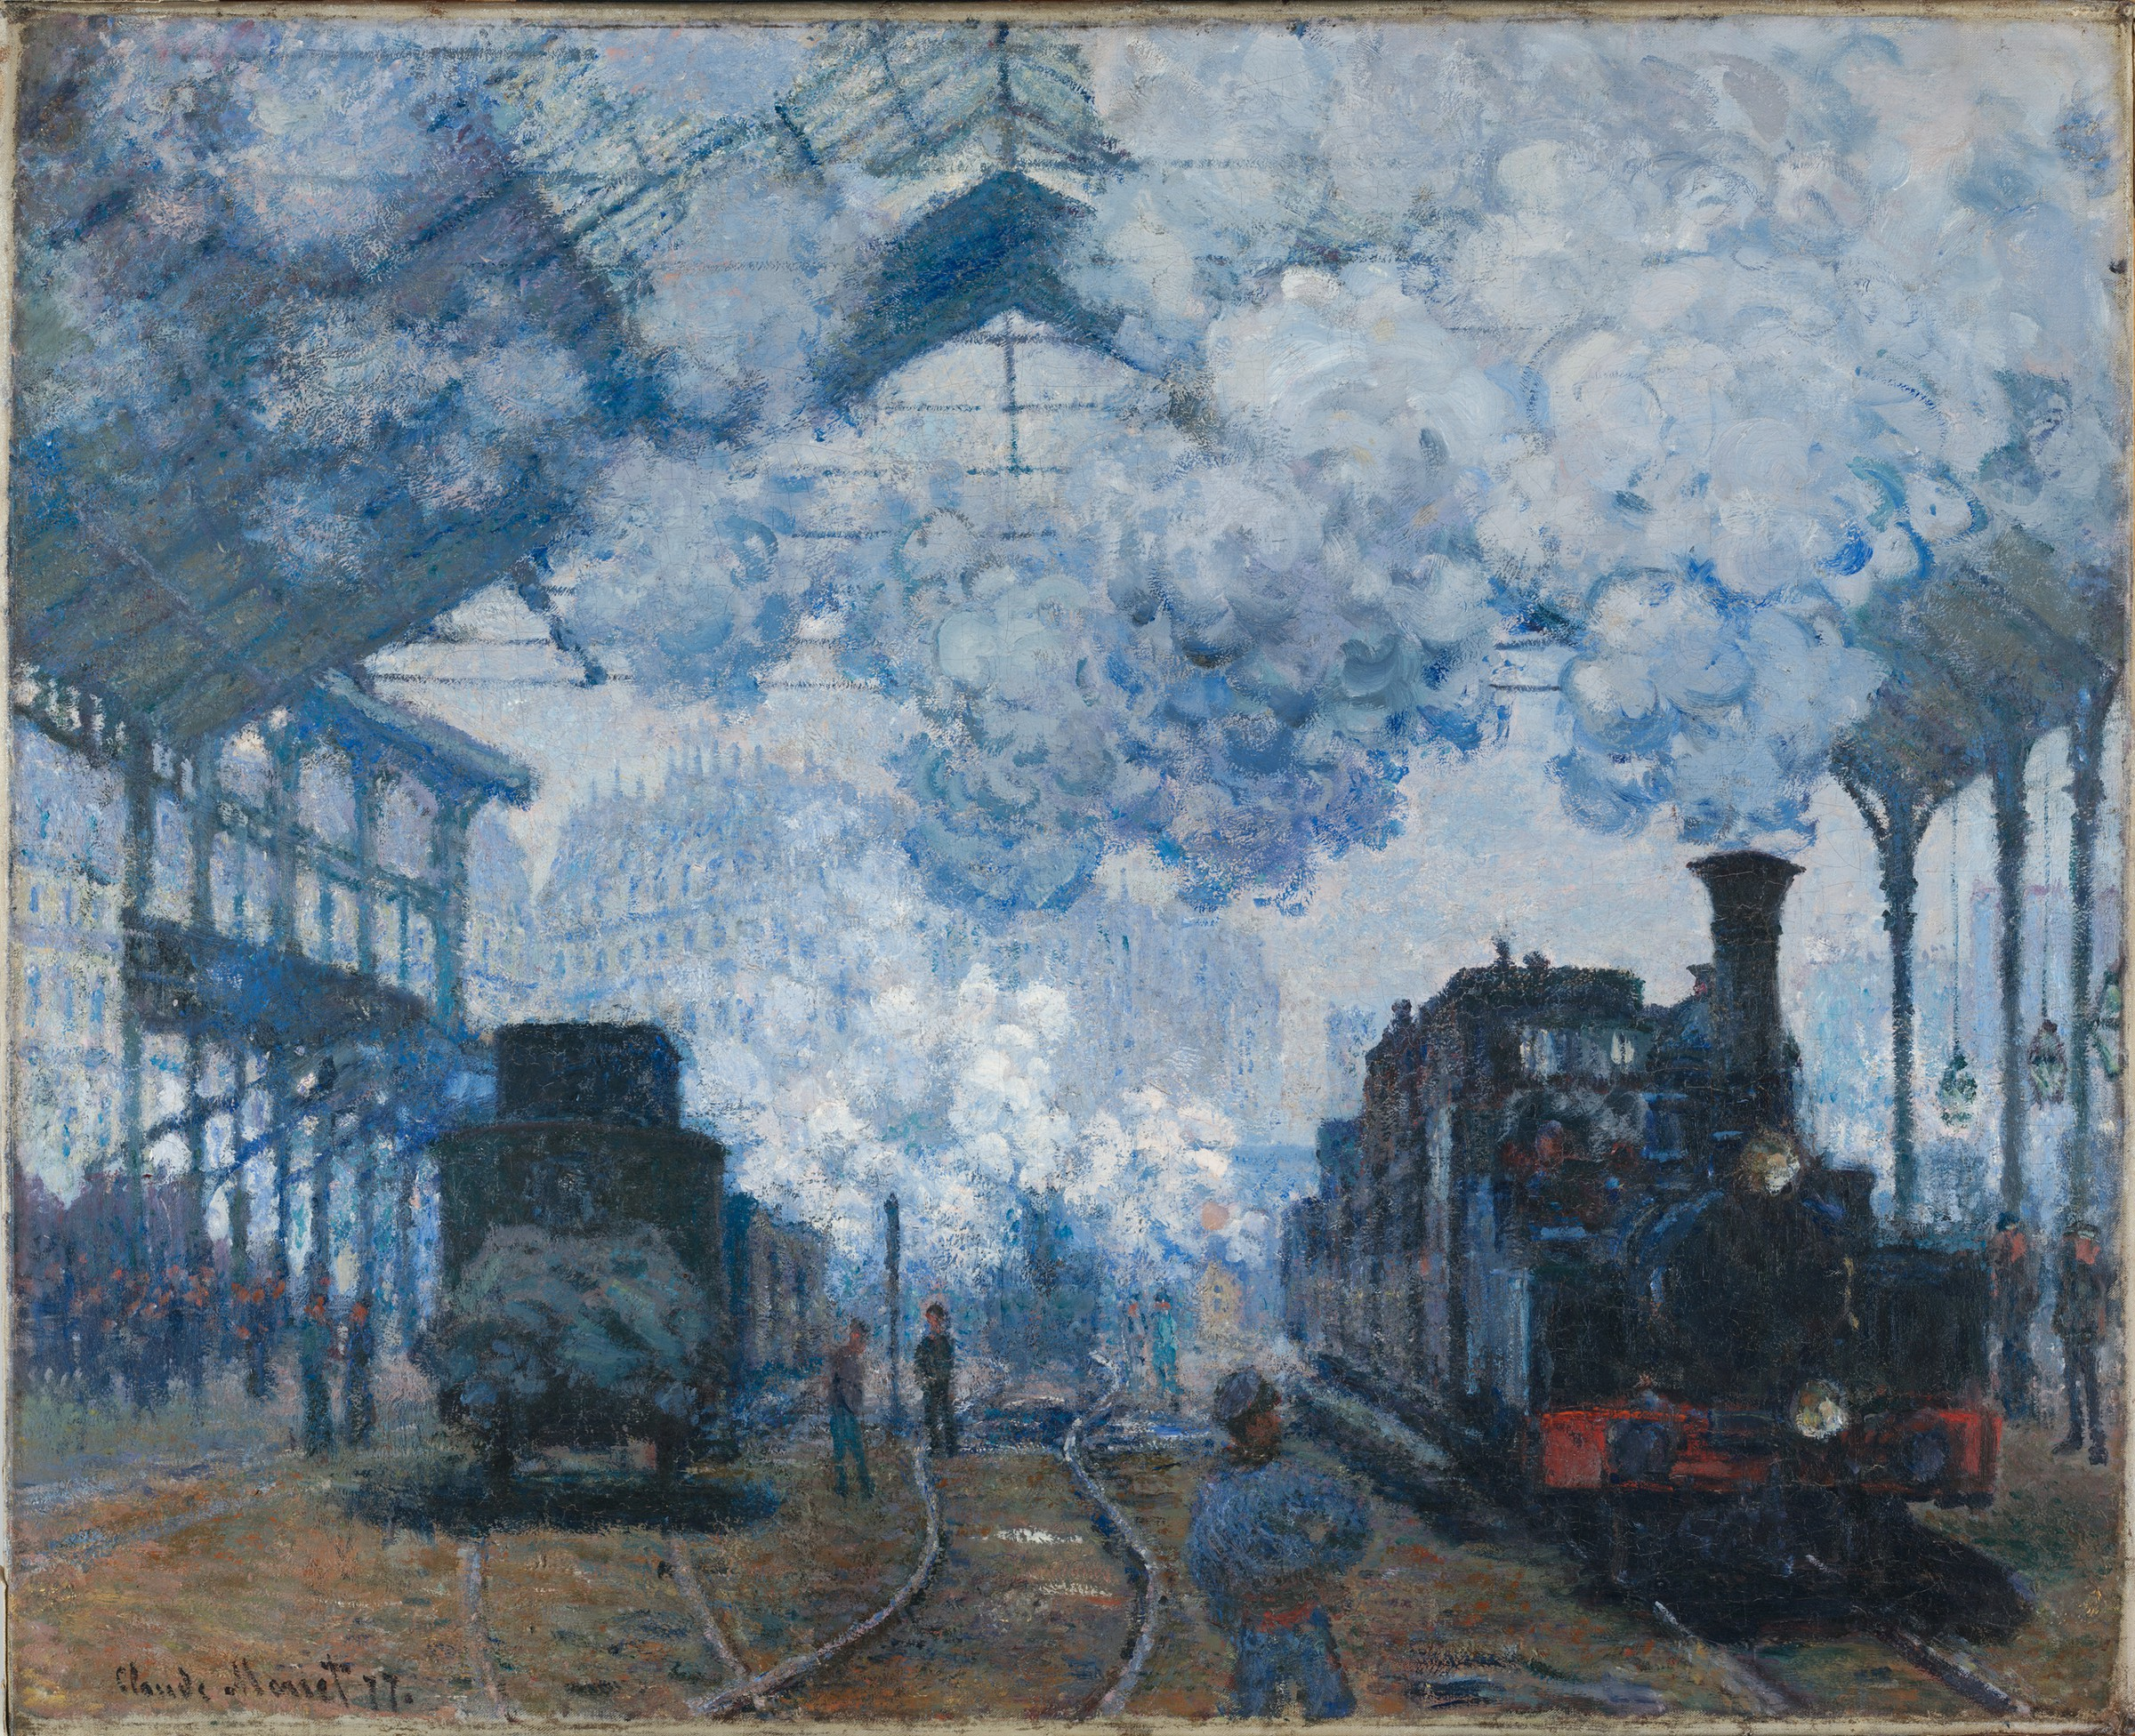
Claude Monet, Gare Saint-Lazare: Arrival of a Train (1877)
Harvard University, Fogg Art Museum

